Slide 1



Name of Project
Water Quality Prediction

Slide 2

Learning Objectives
Apply machine learning to solve a real-world environmental problem.
Preprocess data and perform feature encoding (e.g., one-hot encoding).
Implement multi-output regression to predict multiple pollutants.
Save and load models using joblib for reuse.
Build an interactive web app using Streamlit.
Handle dynamic inputs (year, station ID) for future-ready predictions.
Understand model deployment and real-time prediction concepts.
Strengthen debugging, data alignment, and validation skills.
GOAL
Source :
www.freepik.com/

Slide 3
Tools and Technology used
Programming Language
Python – 3.12 - Used for data processing model building, and analysis
Pandas, NumPy – Data handling
Scikit-learn – Machine learning model and evaluation
Matplotlib, Seaborn – Data visualization
Development Environment
Jupyter Notebook – Code development and visualization
Git & GitHub – Version control and project sharing

Slide 4
Methodology
1.Problem
This project aims to predict multiple water quality parameters using machine learning techniques, specifically MultiOutputRegressor wrapped around a RandomForestRegressor.
2.Data Collection Used a structured dataset with features like pH, hardness, solids, chloramines, etc.
3.Data Preprocessing Handled missing values (e.g., using mean/median imputation) Scaled features for consistent input (StandardScaler/MinMaxScaler) Removed outliers

Slide 5
5. Model Building
Applied multiple ML models:
Logistic Regression
Random Forest
Split data into training and testing sets
6.. Model Evaluation
Compared models based on:
Accuracy
Precision
Recall
F1-score
7.Model Selection
Selected the best-performing model based on evaluation metrics.

Slide 6
8. Result Interpretation
Analyzed important features contributing to water quality prediction.
9. Deployment
Developed a simple UI using Streamlit

Slide 7
Problem Statement:
Ensuring access to safe and clean drinking water is a fundamental public health priority. However, manual testing of water samples for multiple physical and chemical parameters is time-consuming, expensive, and not always feasible in remote areas. This project aims to develop a machine learning-based predictive model that can efficiently estimate water quality parameters and determine whether water is potable based on measurable input features such as pH, hardness, solids, chloramines, and others. The goal is to support faster, automated, and scalable water quality assessment to aid timely decision-making.

Slide 8
Solution:
1.Year Treated as a Continuous Feature:
The year is included as a numerical feature in the model.
This allows the model to learn temporal trends and predict accordingly for any year (e.g., 2022, 2025, 2030).
2. Station ID One-Hot Encoding:
Station ID is converted into a one-hot encoded format, enabling the model to distinguish between different monitoring locations.
3. Feature Alignment Using Saved Column Order:
During training, the column order used for input features is saved (model_columns.pkl).
During prediction, user input is encoded and aligned to this same structure, ensuring compatibility with the trained model.
4. Dynamic Prediction Handling:
The app allows users to enter any year between 2000 and 2100.
For each new year entered, the encoded input is regenerated and passed to the model, which dynamically computes a new prediction based on the learned patterns.

Slide 9
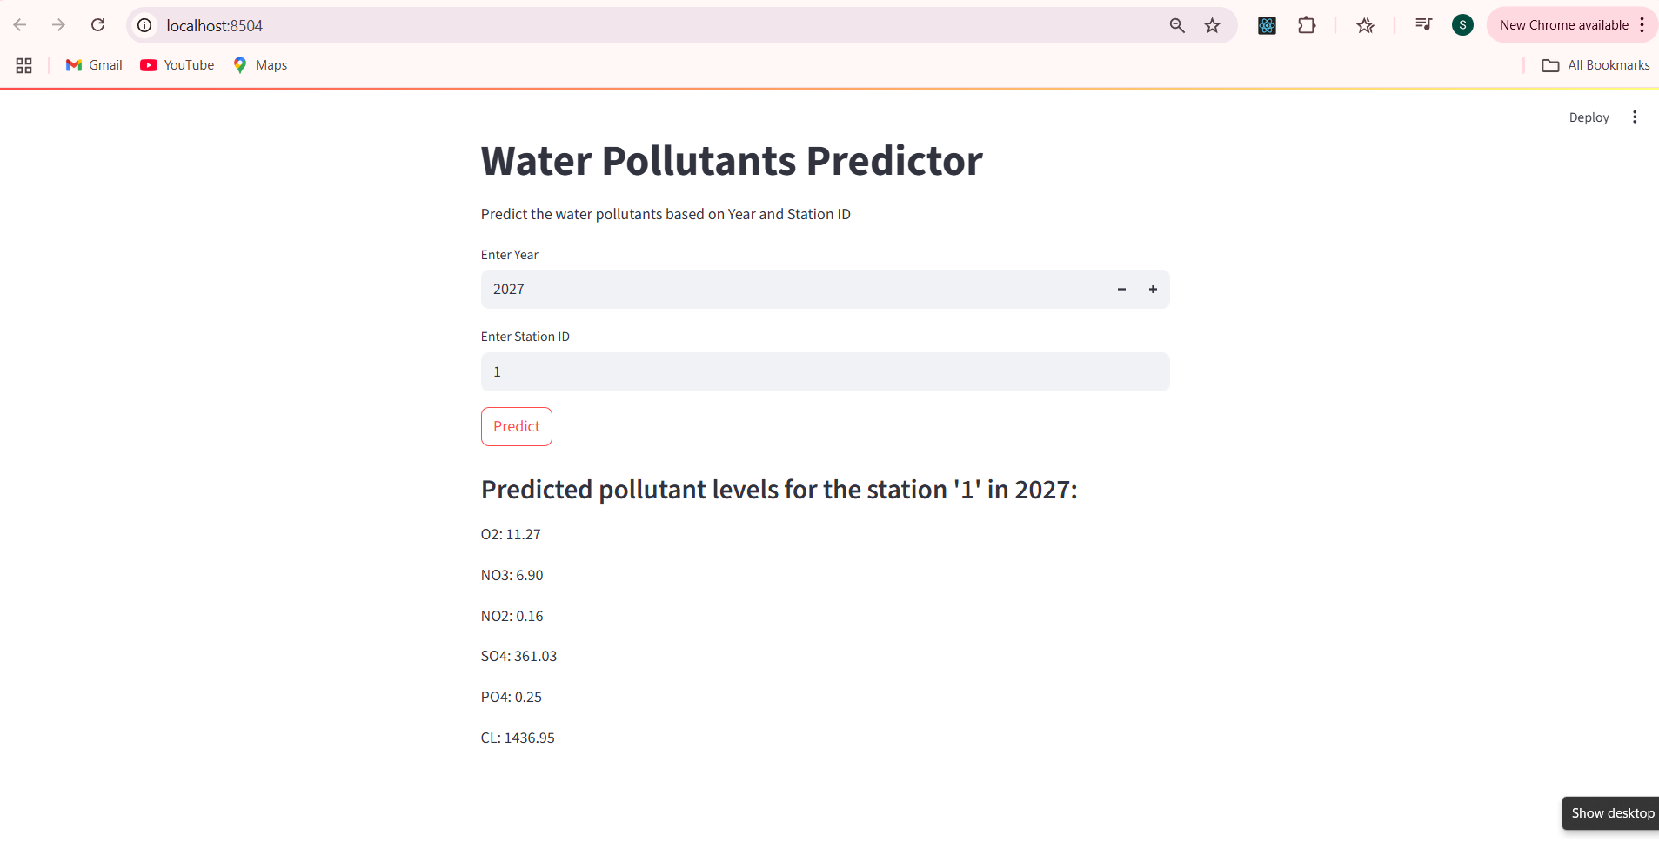
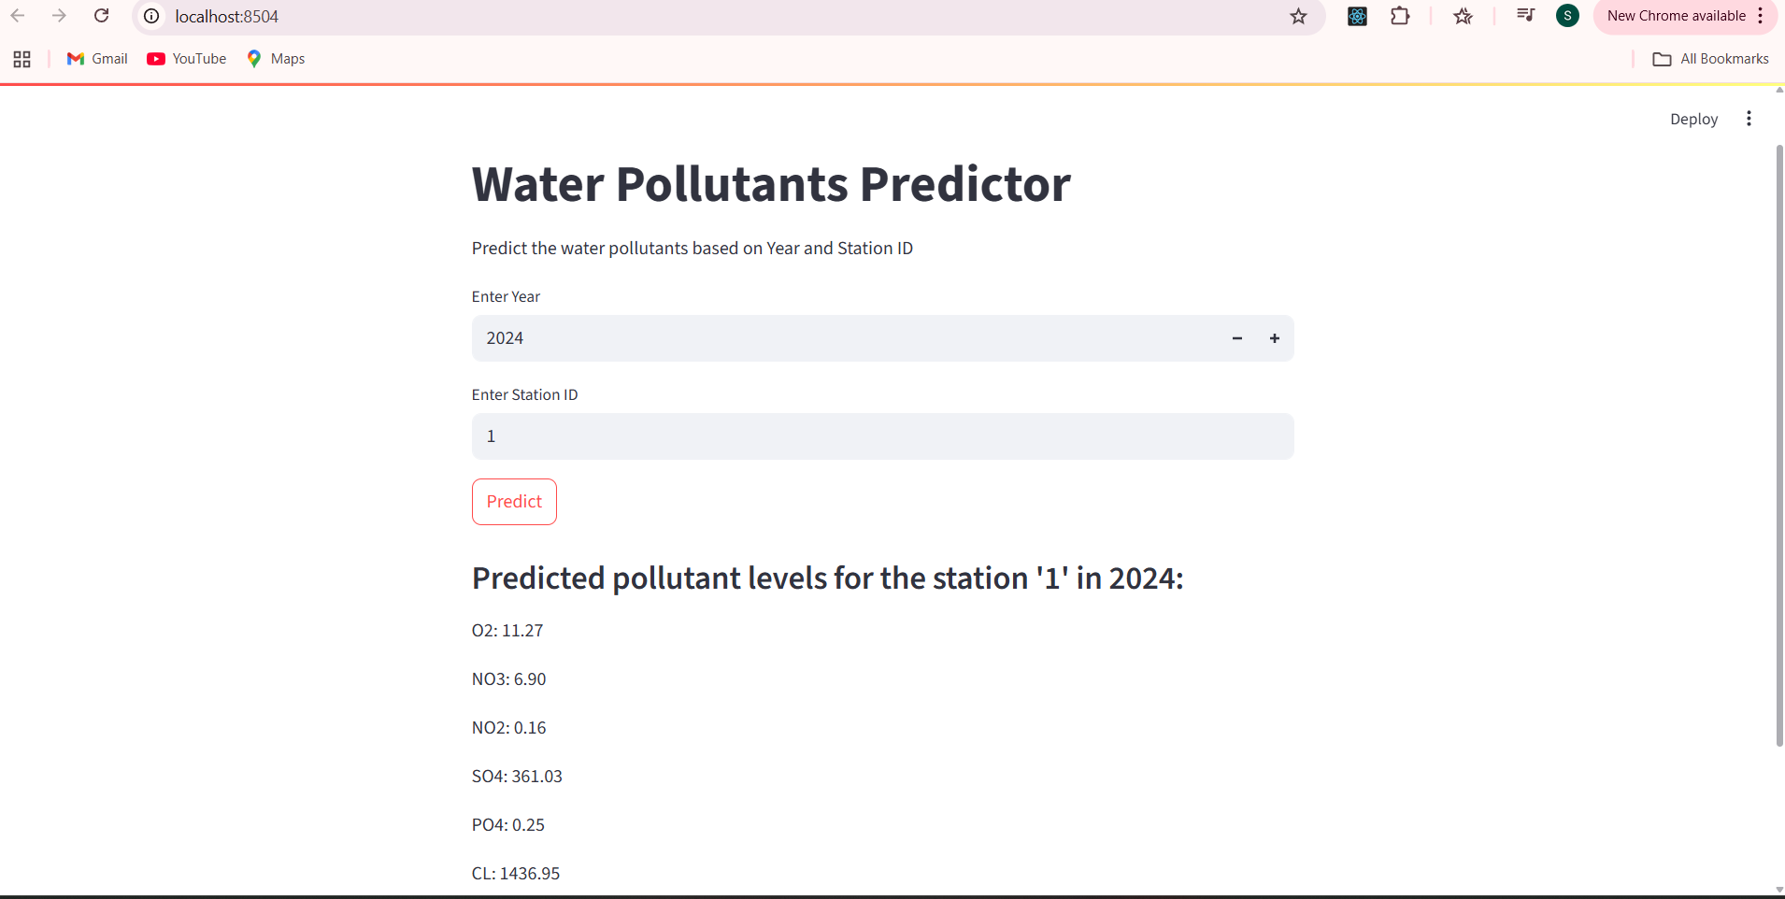
Screenshot of Output:

Slide 10
Streamlit Deployment Process
Model Preparation: Trained a multi-output regression model and saved it using joblib, along with the required input columns.
App Development: Created a Streamlit app (app.py) that accepts user input (year and station ID), processes the data, and uses the model to predict pollutant levels.
Feature Alignment: Ensured input data matches the model’s expected format using one-hot encoding and column alignment.
Running Locally: Used the command streamlit run app.py in the terminal to launch the app in the browser.
User Interface: Built an interactive UI for real-time predictions with input fields and result display.

Slide 11
Conclusion:
The project successfully demonstrates how machine learning can be applied to predict multiple water quality parameters based on key physical and chemical features.
Using a MultiOutputRegressor with a RandomForestRegressor base model allowed for accurate and simultaneous prediction of multiple values.
The automated approach reduces the need for time-consuming manual testing and offers a scalable, cost-effective solution for assessing water potability.
With further refinement and real-time integration, this system can support authorities, researchers, and the public in making faster, data-driven decisions regarding water safety.
Github Link:
https://github.com/Surajkumarmandal7/AICTE-Internships-2025-June_2025-Water-Quality-Prediction

